Slide 1

Fraud Detection
Report : Models with Risk_score dropped after FE & EDA

Slide 2
Features & their correlation
‘Fraud_label’ is our target feature for the dataset, and the two features mentioned here are the most correlated features to the target feature.
In this version of the report, I dropped only the “Risk_score” after doing the FE & EDA.
After, that I used the different Machine Learning models as well as Deep Learning model ANN.
For tree-based models, I didn’t apply any scaling method.
For Distance based models, I used the Min Max scaler.
Fraud_Label 1.000000
Failed_Transaction_Count_7d 0.509871
Risk_Score 0.385810

Slide 3
Distance Based Algorithms
Logistic Regression
SVC
KNN
accuracy_score : 0.8744
Confusion matrix :
[[8388 60]
[1510 2542]]
precision recall f1-score support
0 0.85 0.99 0.91 8448
1 0.98 0.63 0.76 4052
accuracy 0.87 12500
macro avg 0.91 0.81 0.84 12500
weighted avg 0.89 0.87 0.87 12500
accuracy_score : 0.7384
Confusion matrix :
[[8448 0]
[3270 782]]
precision recall f1-score support
0 0.72 1.00 0.84 8448
1 1.00 0.19 0.32 4052
accuracy 0.74 12500
macro avg 0.86 0.60 0.58 12500
weighted avg 0.81 0.74 0.67 12500
accuracy_score : 0.80656
Confusion matrix :
[[7773 675]
[1743 2309]]
precision recall f1-score support
0 0.82 0.92 0.87 8448
1 0.77 0.57 0.66 4052
accuracy 0.81 12500
macro avg 0.80 0.74 0.76 12500
weighted avg 0.80 0.81 0.80 12500

Slide 4
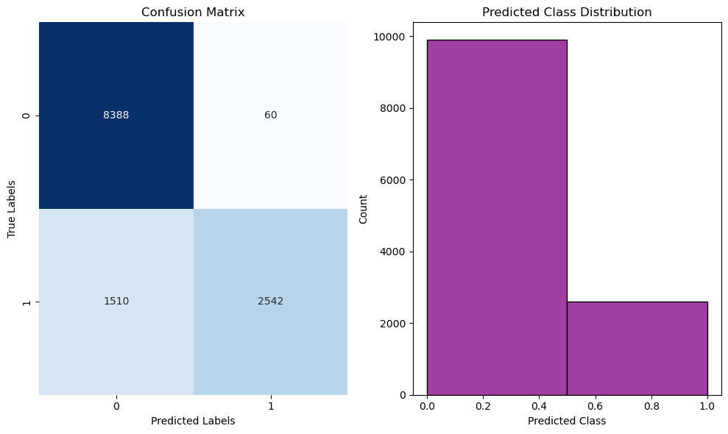
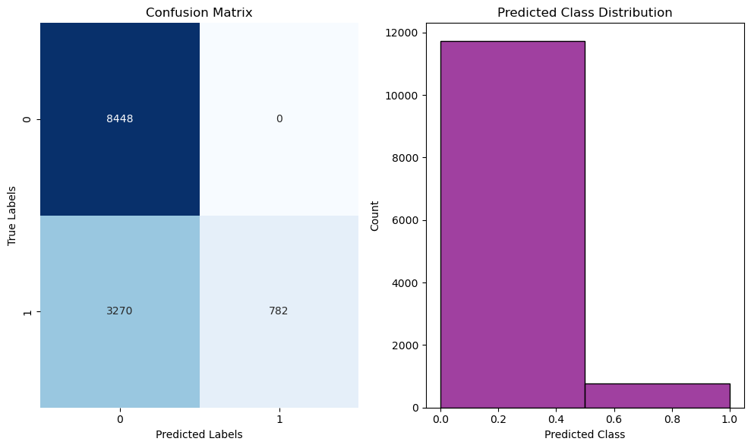
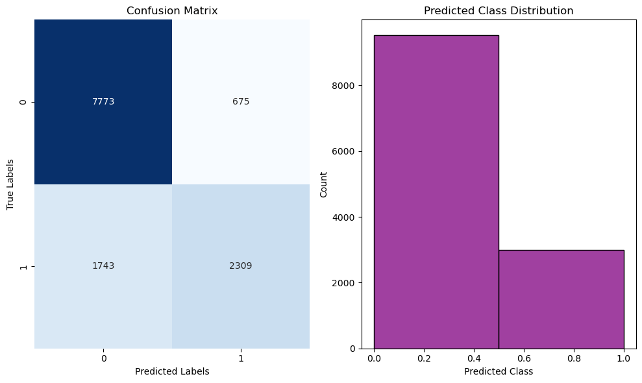
Graphs
Logistic Regression
SVC
KNN

Slide 5

Probability based Algorithm(NB)
accuracy_score : 0.87808
Confusion matrix :
[[8448 0]
[1524 2528]]
precision recall f1-score support
0 0.85 1.00 0.92 8448
1 1.00 0.62 0.77 4052
accuracy 0.88 12500
macro avg 0.92 0.81 0.84 12500
weighted avg 0.90 0.88 0.87 12500

Slide 6
Tree Based Algorithms
Decision Tree
Random Forest
Adaboost
accuracy_score : 0.77632
Confusion matrix :
[[6897 1551]
[1245 2807]]
precision recall f1-score support
0 0.85 0.82 0.83 8448
1 0.64 0.69 0.67 4052
accuracy 0.78 12500
macro avg 0.75 0.75 0.75 12500
weighted avg 0.78 0.78 0.78 12500
accuracy_score : 0.878
Confusion matrix :
[[8447 1]
[1524 2528]]
precision recall f1-score support
0 0.85 1.00 0.92 8448
1 1.00 0.62 0.77 4052
accuracy 0.88 12500
macro avg 0.92 0.81 0.84 12500
weighted avg 0.90 0.88 0.87 12500
accuracy_score : 0.87816
Confusion matrix :
[[8447 1]
[1522 2530]]
precision recall f1-score support
0 0.85 1.00 0.92 8448
1 1.00 0.62 0.77 4052
accuracy 0.88 12500
macro avg 0.92 0.81 0.84 12500
weighted avg 0.90 0.88 0.87 12500

Slide 7
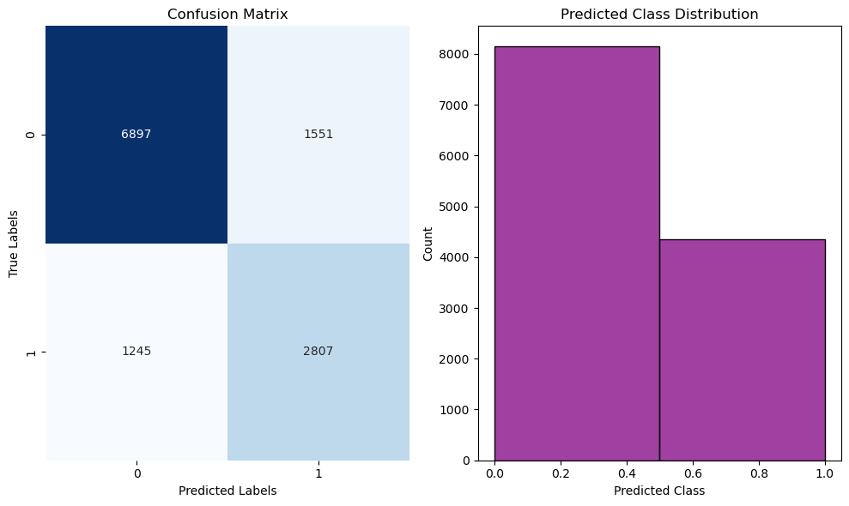


Graphs
Decision Tree
Random Forest
Adaboost

Slide 8

Gradient boost (Tree based)
accuracy_score : 0.87784
Confusion matrix :
[[8444 4]
[1523 2529]]
precision recall f1-score support
0 0.85 1.00 0.92 8448
1 1.00 0.62 0.77 4052
accuracy 0.88 12500
macro avg 0.92 0.81 0.84 12500
weighted avg 0.90 0.88 0.87 12500

Slide 9

ANN(Deep learning model)
accuracy_score : 0.87792
Confusion matrix :
[[8448 0]
[1526 2526]]
precision recall f1-score support
0 0.85 1.00 0.92 8448
1 1.00 0.62 0.77 4052
accuracy 0.88 12500
macro avg 0.92 0.81 0.84 12500
weighted avg 0.90 0.88 0.87 12500

